Slide 1
Relational Database Management System
Module 1
Jan 2025-May 2025

Slide 2
Introduction
Introduction
Characteristics of databases
Comparison of File system and Database approach
Users of Database system
Concerns when using an enterprise database
Data Independence
DBMS system architecture
Database Administrator

Slide 3
Drawbacks of using file systems to store data
Data redundancy and inconsistency
Multiple file formats, duplication of information in different files
Difficulty in accessing data
Need to write a new program to carry out each new task
Data isolation
Multiple files and formats
Integrity problems
It ensures that data remains correct and valid throughout its lifecycle, from creation to modification and deletion.
Hard to add new constraints or change existing ones
Notes:
3

Slide 4
Drawbacks of using file systems to store data (Cont.)
Concurrent access by multiple users
Concurrent access needed for performance
Uncontrolled concurrent accesses can lead to inconsistencies
Example: Two people reading a balance (say 100) and updating it by withdrawing money (say 50 each) at the same time
Security problems
Hard to provide user access to some, but not all, data
Database systems offer solutions to all the above problems
Notes:
4

Slide 5
DBMS
Database: A database is an organized collection of data.
DBMS: A database management system (DBMS) is system software for creating and managing databases.
DBMS is Collection of interrelated data
It has set of programs to access the data
DBMS provides an environment that is both convenient and efficient to use
DBMS contains information about a particular enterprise
Examples: Microsoft Access, File-based systems like XML, CSV.
RDBMS (Relational Database Management System)
Definition: An RDBMS is a type of DBMS that stores data in a structured format using tables and enforces relationships between these tables through keys (e.g., primary keys and foreign keys).
Data Storage: Data is stored in tables, and relationships between tables are strictly defined.
Examples: MySQL, PostgreSQL, Oracle Database, Microsoft SQL Server.

Slide 6
Advantages of DBMS
Redundancy reduced: As there is centralized database redundancy is reduced.
Less Inconsistency: As redundancy is reduced data inconsistency will be reduced
More Integrity: Integrity constraints can be added so data will be more accurate
No Data Isolation: As there is centralized database
More Security: Privileges can be given to the users and data can be secured
Concurrent access by multiple users: Controlled concurrent access to multiple users is possible to increase the performance.

Slide 7
Example
Table: Student
Table: Student_marks
Name | Roll Number | Class | Div
John Smith | 101 | SY | C
Emma Johnson | 102 | SY | C
Liam Williams | 103 | SY | C
Roll Number | Subject | Marks
101 | DBMS | 85
101 | OS | 90
102 | DBMS | 78
102 | OS | 88
103 | DBMS | 78
103 | OS | 85

Slide 8
Importance of “big data”
Government
Private Sector
Walmart handles more than 1 million customer transactions every hour, which is imported into databases estimated to contain more than 2.5 petabytes of data
Facebook handles 40 billion photos from its user base
Falcon Credit Card Fraud Detection System protects 2.1 billion active accounts world-wide
Science
Large Synoptic Survey Telescope will generate 140 Terabyte of data every 5 days
Biomedical computation like decoding human Genome and personalized medicine

Slide 9

Lifecycle of Data: 4 “A”s
2. Aggregation
Scattered data
Integrated data
1. Acquisition
3. Analysis
Log data
Knowledge
4. Application

Slide 10
Basic Definitions
Database:
A collection of related data.
Data:
Known facts that can be recorded and have an implicit meaning.
Database Management System (DBMS):
A software package/system to facilitate the creation and maintenance of a computerized database.
Database system:
The DBMS software together with the data itself. Sometimes, the applications are also included.

Slide 11
Applications interact with a database by generating
Queries: that access different parts of data and formulate the result of a request
- Transactions: that may read some data and “update” certain values or generate new data and store that in the database

Slide 12
Characteristics of the Database Approach
Self-describing nature of a database system:
A DBMS catalog stores the description of a particular database (e.g. data structures, types, and constraints)
The description is called meta-data*.
This allows the DBMS software to work with different database applications.
Insulation between programs and data:
Called program-data independence.
Allows changing data structures and storage organization without having to change the DBMS access programs

Slide 13
Characteristics of the Database Approach (..contd)
Data abstraction:
A data model is used to hide storage details and present the users with a conceptual view of the database.
Programs refer to the data model constructs rather than data storage details
Support of multiple views of the data:
Each user may see a different view of the database, which describes only the data of interest to that user.

Slide 14
Characteristics of the Database Approach (..contd)
Sharing of data and multi-user transaction processing:
Allowing a set of concurrent users to retrieve from and to update the database.
Concurrency control within the DBMS guarantees that each transaction is correctly executed or aborted
Recovery subsystem ensures each completed transaction has its effect permanently recorded in the database
OLTP (Online Transaction Processing) is a major part of database applications; allows hundreds of concurrent transactions to execute per second.

Slide 15
Advantages of Using the Database Approach
Controlling redundancy in data storage and in development and maintenance efforts.
Sharing of data among multiple users.
Restricting unauthorized access to data. Only the DBA staff uses privileged commands and facilities.
Providing persistent storage for program Objects
E.g., Object-oriented DBMSs make program objects persistent
Providing storage structures (e.g. indexes) for efficient query
Providing optimization of queries for efficient processing
Providing backup and recovery services
Providing multiple interfaces to different classes of users
Representing complex relationships among data
Enforcing integrity constraints on the database
Drawing inferences and actions from the stored data using deductive and active rules and triggers

Slide 16
Advantages of Using the Database Approach
Potential for enforcing standards:
Standards refer to data item names, display formats, screens, report structures, meta-data (description of data), Web page layouts, etc.
Reduced application development time:
Incremental time to add each new application is reduced.
Flexibility to change data structures:
Database structure may evolve as new requirements are defined.
Availability of current information:
Extremely important for on-line transaction systems such as shopping, airline, hotel, car reservations.
Economies of scale:
Wasteful overlap of resources and personnel can be avoided by consolidating data and applications across departments.

Slide 17
Limitations of the Database Approach
Main inhibitors (costs) of using a DBMS:
High initial investment and possible need for additional hardware
Overhead for providing generality, security, concurrency control, recovery, and integrity functions
When a DBMS may be unnecessary:
If the database and applications are simple, well defined, and not expected to change
If access to data by multiple users is not required
When a DBMS may be infeasible
In embedded systems where a general-purpose DBMS may not fit in available storage
When no DBMS may suffice:
If the database system is not able to handle the complexity of data because of modeling limitations
If the database users need special operations not supported by the DBMS

Slide 18
Data Schemas and Database Instance
Database Schema:
The description of a database.
Includes descriptions of the database structure, data types, and the constraints on the database.
Example:
BookID INT PRIMARY KEY, Title VARCHAR(255) NOT NULL, Author VARCHAR(255), Publisher VARCHAR(255), YearPublished INT
Schema Diagram:
An illustrative display of (most aspects of) a database schema.
Schema Construct:
A schema construct refers to the various elements or components that define the structure of a database schema.
These constructs collectively represent how the data is organized, stored, and related within the database.
In simpler terms, schema constructs are the building blocks of a database schema, such as tables, fields, keys, relationships, and constraints.
.

Slide 19
Data Schemas and Database Instance
Database State / database instance (or occurrence or snapshot):
The actual data stored in a database at a particular moment in time. This includes the collection of all the data in the database.
The term instance is also applied to individual database components, e.g. record instance, table instance, entity instance

Slide 20
Data Schemas and Database Instance
Database State / database instance (or occurrence or snapshot):
Database State:
Refers to the content of a database at a moment in time.
Initial Database State:
Refers to the database state when it is initially loaded into the system.
Valid State:
A state that satisfies the structure and constraints of the database.
Distinction
The database schema changes very infrequently.
The database state changes every time the database is updated.
Schema is also called intension.
State is also called extension.

Slide 21
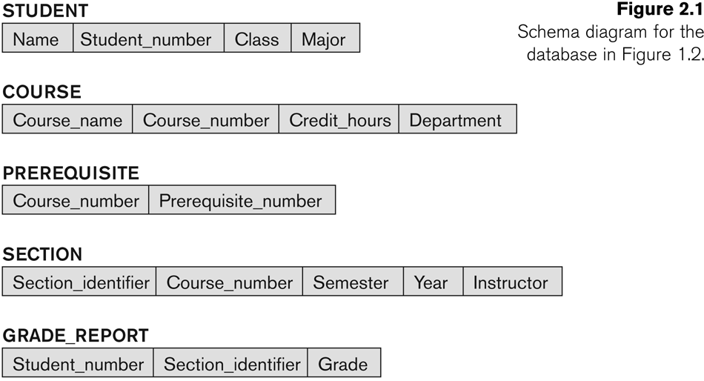
Data Schemas

Slide 22

Database Instance

Slide 23
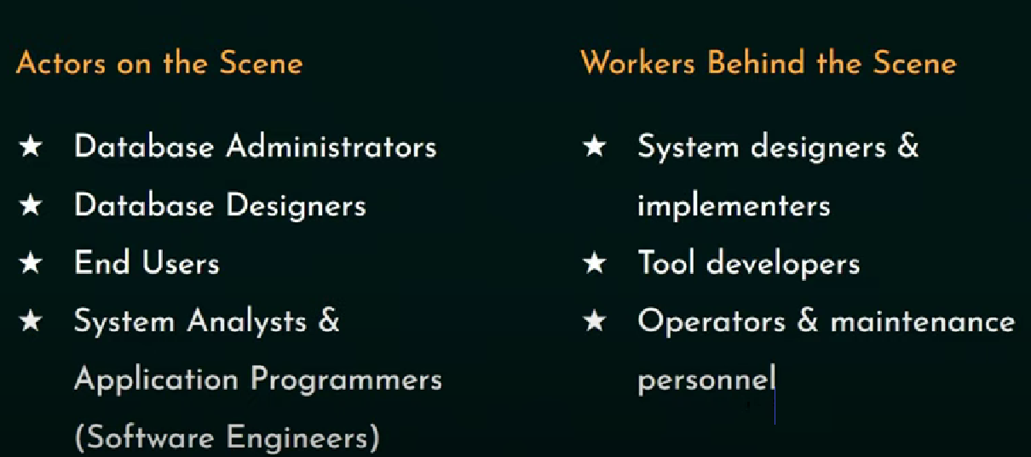
Database Users

Slide 24
Database users
Users may be divided into
Those who actually use and control the database content, and those who design, develop and maintain database applications (called “Actors on the Scene”)
Those who design and develop the DBMS software and related tools, and the computer systems operators (called “Workers Behind the Scene”).

Slide 25
Database users: Actors on the scene
Database Administrator
Coordinates all activities related to database systems
Has good understanding of the enterprise’s information
Administrator's duties include:
Schema definition
Storage structure and access method definition
Schema and physical organization modification
Granting user authorities to access database
Specifying integrity constraints
Acting as linked with users
Monitoring performance and responding to changes in requirements
Example:
A DBA at an e-commerce company creates user accounts for employees, grants permissions, and schedules daily backups to prevent data loss.

Slide 26
Database users: Actors on the scene
Database designers
Identifying the data to be stored in the database.
Communicating with database users , understand their requirements and design database.
Database designers create the structure of the database, such as the schema, tables, relationships, and constraints.
They ensure that the database is optimized for performance and can handle the required data efficiently.
Example:
A database designer for a hospital management system defines tables for Patients, Doctors, and Appointments, ensuring the appropriate relationships between them.

Slide 27
Database users: Actors on the scene
End-users: They use the data for queries, reports and some of them update the database content.
End-users can be categorized into:
1. Casual: access database occasionally when needed.
Example: A manager queries the sales database to generate a monthly revenue report.
2. Naïve or parametric:
They use previously well-defined functions in the form of “canned transactions” against the database.
Regularly perform predefined operations using specific applications.
Users of mobile apps mostly fall in this category
A bank teller uses software to fetch and update customer account details.
Social media users post and read information from websites

Slide 28
Database users: Actors on the scene
3. Sophisticated:
Many use tools in the form of software packages that work closely with the stored database.
Use advanced tools or write queries directly. Example: A data analyst uses SQL to extract trends from customer purchase data.
4. Stand-alone:
Mostly maintain personal databases using ready-to-use packaged applications.
Example: A researcher uses MS Access for managing survey data.
Another example is a user that maintains a database of personal photos and videos.

Slide 29
Database users: Actors on the scene
System analysts and application developers
System analysts:
They understand the user requirements of naïve and sophisticated users and design applications including canned transactions to meet those requirements.
Example:
A system analyst gathers requirements for an inventory management system and ensures the database aligns with the operational needs.
Application programmers
Implement the specifications developed by analysts.
Developers write programs or applications that interact with the database. They use programming languages and query the database using SQL
Example:
A software developer writes a Python script that retrieves product details from the database and displays them on an e-commerce website.

Slide 30
Database users: Actors behind the scene
System designers and implementors:
Design and implement DBMS packages in the form of modules and interfaces and test and debug them.
The DBMS must interface with applications, language compilers, operating system components, etc.
Tool developers:
Design and implement software systems called tools for modeling and designing databases, performance monitoring, prototyping, test data generation, user interface creation, simulation etc. that facilitate building of applications and allow using database effectively.
Operators and maintenance personnel:
They manage the actual running and maintenance of the database system hardware and software environment.

Slide 31
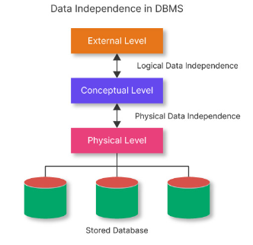
Data Independence

Slide 32
Data independence
Definition:
The ability of the data to change the schema at one level of the database without having to change the schema at the next higher level
In simple words:
It allows the User or Database Administrator to change the schema at one level without affecting the data or schema at another level.

Slide 33
There are two levels of data independence in DBMS:
Physical level data independence
Logical level data independence
1. Physical Level Data Independence
Physical Data Independence can be defined as the ability to change the physical level without affecting the logical or Conceptual level.
Physical data independence gives us the freedom to modify the - Storage device, File structure, location of the database, etc. without changing the definition of conceptual or view level.
Example: For example, if we take the database of the banking system and we want to scale up the database by changing the storage size and also want to change the file structure, we can do it without affecting any functionality of logical schema.
Below changes can be done at the physical layer without affecting the conceptual layer -
Changing the storage devices like SSD, hard disk and magnetic tapes, etc.
Changing the access technique and modifying indexes.
Changing the compression techniques or hashing algorithms.

Slide 34
2. Logical Level Data Independence
Logical Data Independence is a property of a database that can be used to change the logic behind the logical level without affecting the other layers of the database.
Logical data independence is usually required for changing the conceptual schema without having to change the external schema or application programs.
It allows us to make changes in a conceptual structure like adding, modifying, or deleting an attribute in the database.
Example:
If there is a database of a banking system and we want to add the details of a new customer or we want to update or delete the data of a customer at the logical level data will be changed but it will not affect the Physical level or structure of the database.
Adding a New Attribute:
Suppose a database table Employee initially has the attributes EmployeeID, Name, and Department. If the attribute Salary is added to the logical schema, applications querying EmployeeID and Name will still work without modification.

Slide 35
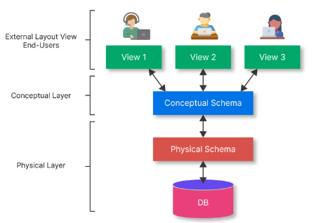
Data abstraction
Achieving Data Independence in DBMS Through Data Abstraction
Data Abstraction can be defined as extracting the necessary data by ignoring the remaining irrelevant details.
Example: ATM

Slide 36
There are three levels of abstraction
Physical or Internal Level -
Physical level is the lowest level of data abstraction, and It indicates how the data will be stored and describes the complex data structures and access methods to be used by the database.
The internal level is used to describe the entire database architecture.
Conceptual or Logical Level -
The separation of the conceptual view from the internal view enables us to provide a logical description of the database concepts without the need to specify physical structures.
The conceptual level comes between the physical level and the view level.
It provides the link between the external schema and the internal schema of the database.
External or View Level - It is the highest level of data abstraction.
The external level describes the user interaction with the centralized database management system.
This level is used to provide a Graphical User Interface to the user, and the user does not know about the file structure, access method, and other internal details of the database.

Slide 37
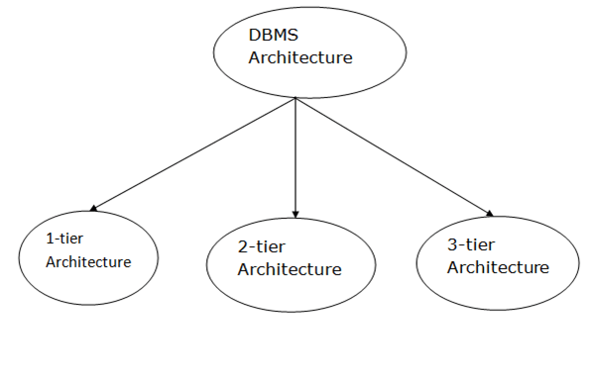
Types of DBMS Architecture

Slide 38
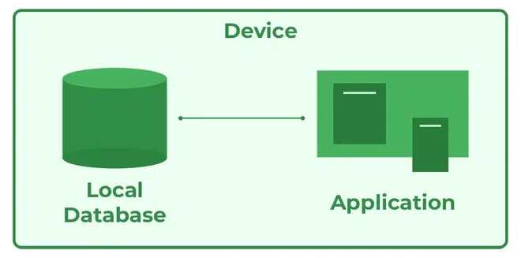
1-Tier Architecture
In this architecture, the database is directly available to the user. It means the user can directly sit on the DBMS and uses it.
Any changes done here will directly be done on the database itself. It doesn't provide a handy tool for end users.
The 1-Tier architecture is used for development of the local application, where programmers can directly communicate with the database for the quick response.

Slide 39
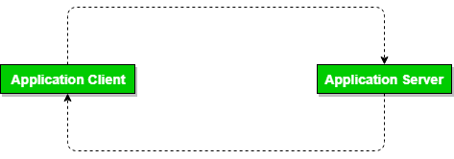
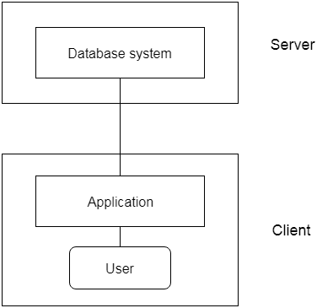
2-Tier Architecture
The 2-tier architecture is similar to a basic client-server model.
In the two-tier architecture, applications on the client end can directly communicate with the database at the server side. For this interaction, API's like: ODBC, JDBC are used.
The user interfaces and application programs are run on the client-side.
The server side is responsible to provide the functionalities like: query processing and transaction management.
To communicate with the DBMS, client-side application establishes a connection with the server side.

Slide 40
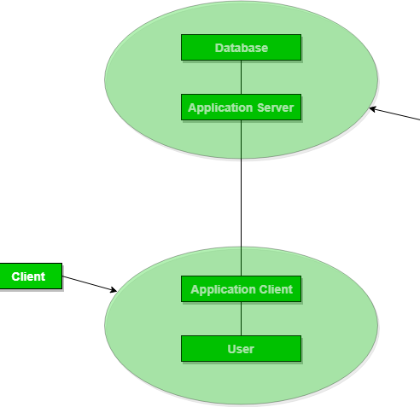
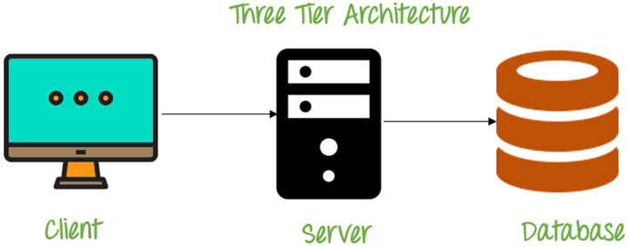
3-Tier Architecture
The 3-Tier architecture contains another layer between the client and server.
In this architecture, client can't directly communicate with the server.
The application on the client-end interacts with an application server which further communicates with the database system.
End user has no idea about the existence of the database beyond the application server. The database also has no idea about any other user beyond the application.
The 3-Tier architecture is used in case of large web application.

Slide 41
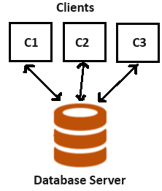
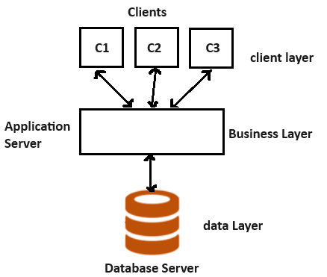
2-Tier
3-Tier

Slide 42
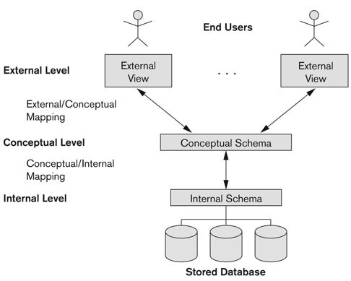
Three schema Architecture
Defines DBMS schemas at three levels:
Internal schema at the internal level to describe physical storage structures and access paths ( e.g. indexes).
Typically uses a physical data model.
Conceptual schema at the conceptual level to describe the structure and constraints for the whole database for a community of users.
Uses a conceptual or an implementation data model.
External schemas at the external level to describe the various user views.
Usually uses the same data model as the conceptual schema.

Slide 43
Three schema Architecture mapping
Mapping is used to transform the request and response between various database levels of architecture.
Mapping is not good for small DBMS because it takes more time.
In External / Conceptual mapping, it is necessary to transform the request from external level to conceptual schema.
In Conceptual / Internal mapping, DBMS transform the request from the conceptual to internal level.

Slide 44
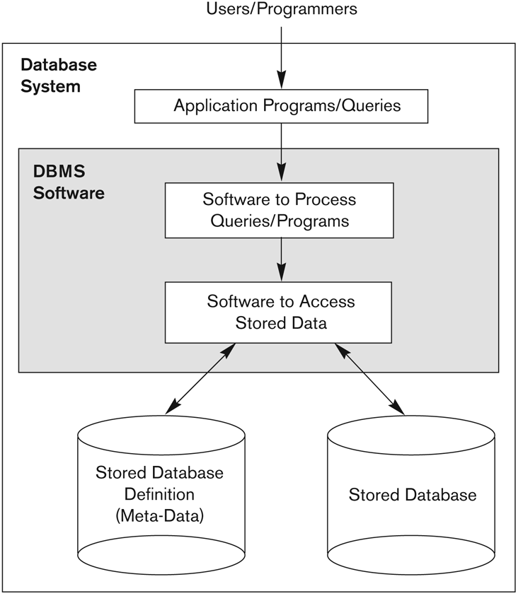
A simplified architecture of Database System

Slide 45
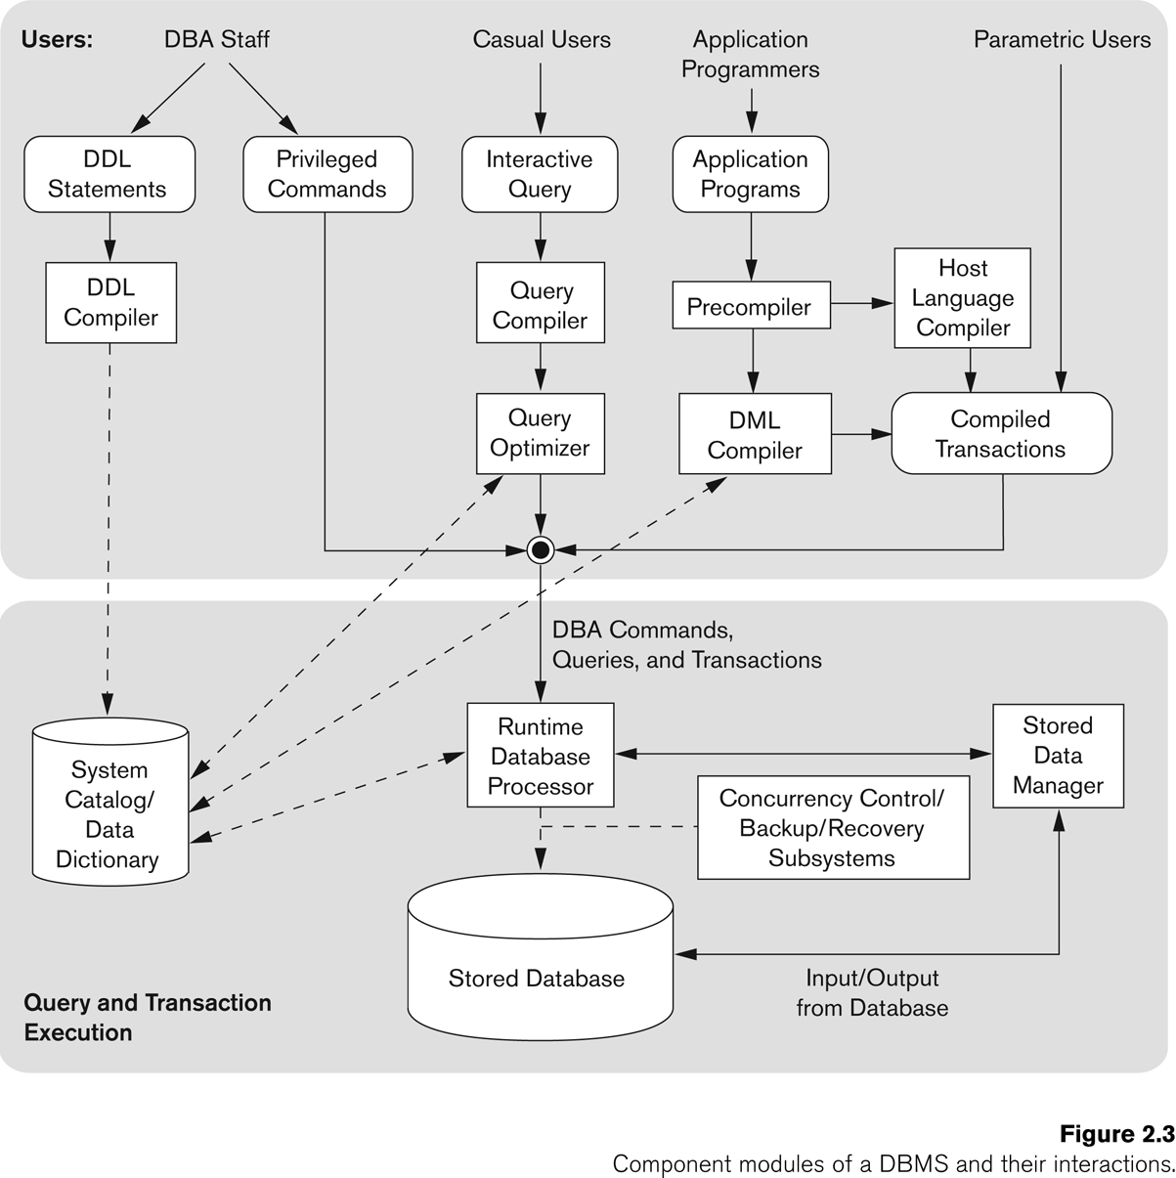
A simplified architecture of Database System

Slide 46
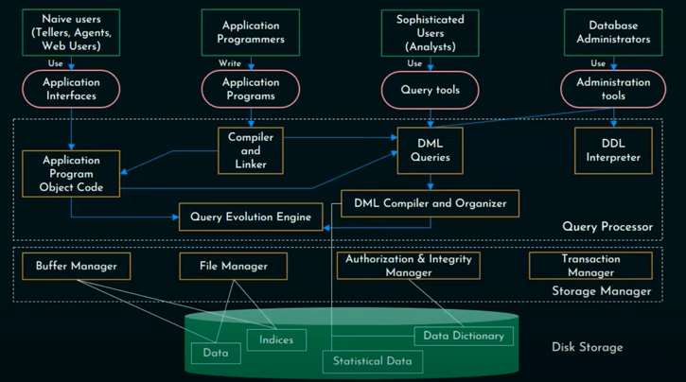
A simplified architecture of Database System

Slide 47
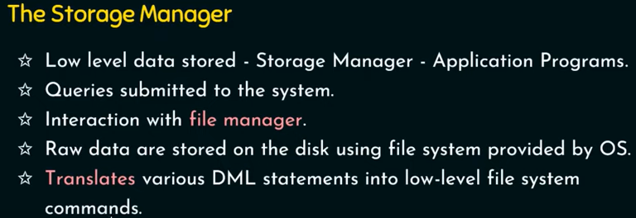
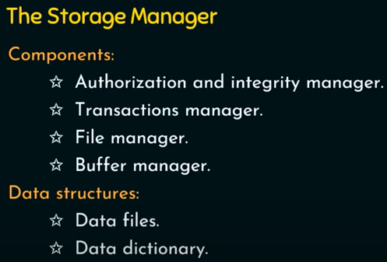
Buffer manager-cache the data on priority. Handle memory management
File manager- disk space management and data structure allocation
Authorization and integrity manager
Transaction Manager

Slide 48
Storage Management

Slide 49
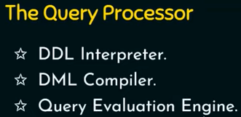

Slide 50
Data Model
Data Model:
A set of concepts to describe the structure of a database, the operations for manipulating these structures, and certain constraints that the database should obey.
Data Model Structure and Constraints:
Constructs are used to define the database structure
Constructs typically include elements (and their data types) as well as groups of elements (e.g. entity, record, table), and relationships among such groups
Constraints specify some restrictions on valid data; these constraints must be enforced at all times
Data Model Operations:
These operations are used for specifying database retrievals and updates by referring to the constructs of the data model.
Operations on the data model may include basic model operations (e.g. generic insert, delete, update) and user-defined operations (e.g. compute_student_gpa, update_inventory)

Slide 51
Data Model Categories
Conceptual (high-level, semantic) data models:
Provide concepts that are close to the way many users perceive data.
(Also called entity-based or object-based data models.)
Physical (low-level, internal) data models:
Provide concepts that describe details of how data is stored in the computer. These are usually specified in an ad-hoc manner through DBMS design and administration manuals
Implementation (representational) data models:
Provide concepts that fall between the above two, used by many commercial DBMS implementations (e.g. relational data models used in many commercial systems).

